Slide 1
Data Visualization and it’s Insights
Team Lead
Ananya Shamal

Slide 2
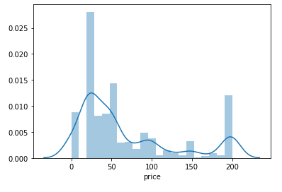
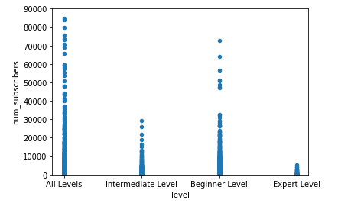
Visualization

Slide 3
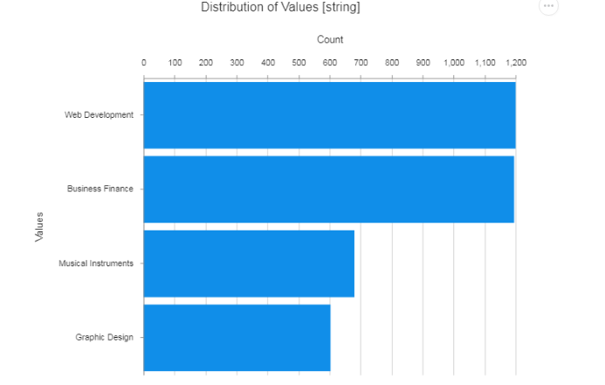
Visualization for subjects from the udemy dataset

Slide 4
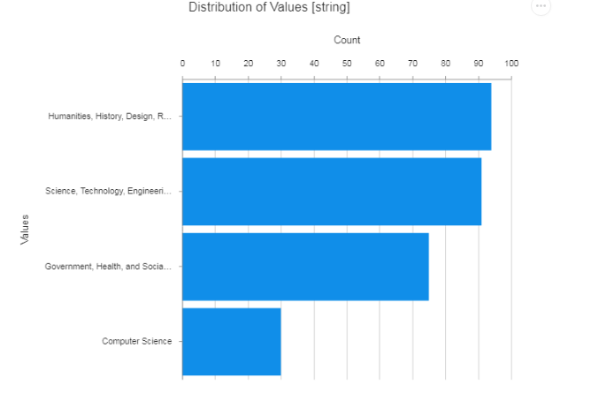
Visualization for subjects from the harvard dataset

Slide 5
Insights from udemy dataset
Dataset has the course record from 2011 to 2017, it mostly provides the four courses ( business finance, web development, musical instruments and graphic design).
Web development was the most opted course of the era and most of the courses were of intermediate and all levels.
Even udemy provides the free and paid courses, so people opted accordingly.
Subscriber are very less.

Slide 6
Insights from harvard
In these dataset we can observe more number of course_subjects than udemy.
With in the same year duration, harvard have provided many different courses for free to audit.
Even though it provides free audit, but the companies require the certifications to authorize.

Slide 7
Overall conclusion
People biased to Web development course in Udemy, but whereas in it had wide range of variates, so people with computers background can choose one of them rather going for web development.
Lack of knowledge in choosing a course.
As we see most of the data record is old, but when we compare it today’s situation, people tend to take more courses.
To improve the subscriptions we need to wide variates of courses.

